Slide 1
Phonics Workshop

Slide 7
Segmenting is the opposite to blending and means breaking a word up into its phonemes to spell/write them.

Slide 15
In school, we follow the Letters and Sounds programme. Letters and Sounds is a phonics resource published by the Department for Education and Skills which consists of six phases. We deliver this 4 times a week, at the same time across Class One and Two.

Slide 16
Phase 1
There are 7 aspects with 3 strands. These are generally covered in Nursery.
A1 – Environmental
A2 – Instrumental sounds
A3 – Body Percussion
A4 – Rhythm and rhyme
A5 – Alliteration
A6 – Voice sounds
A7 – Oral blending and segmenting.

Slide 17
Phase 2
Phase 2 is where the letter sounds are introduced. This starts at the end of Nursery and moves into reception. They are introduced in a specific order. We now have books that correspond to these sets.
Set 1: s, a, t, p
Set 2: i, n, m, d
Set 3: g, o, c, k
Set 4: ck, e, u, r
Set 5: h, b, f, ff, l, ll, ss

Slide 18
An essential part of Phase 2 is beginning to
segment and blend words in order to read
and write them.
e.g. c-a-t
(knowing there are 3 sounds in cat)

Slide 19
PURE SOUNDS
From Phase 2 we also encourage pure sounds.
By pronouncing our sounds in this way
it is easier to segment and blend them
and supports spelling.

Slide 20
Phase 3
Phase 3 is where we introduce digraphs (two or three letter sounds)
Set 6: j, v, w, x
Set 7: y, z, zz, qu
Consonant digraphs: ch, sh, th, ng
Vowel digraphs: ai, ee, igh, oa, oo, ar, or, ur, ow, oi, ear, air, ure, er

Slide 21
Also don’t forget the great resources available on
EDUCATION CITY
For phases 2-5

Slide 22
Phase 4
This phase consolidates all the children have learnt in the previous phases. It is also the introduction of adjacent consonants e.g. CCVC words and a good time to practise real and nonsense words and sentence substitution.

Slide 23
Phase 5
In this phase children will be taught new graphemes and alternative pronunciations for these graphemes.
Vowel digraphs: wh, ph, ay, ou, ie, ea, oy, ir, ue, aw, ew, oe, au
Split digraphs: a_e, e_e, i_e, o_e, u_e

Slide 24
Phase 6
In this phase the focus is on learning spelling rules such as suffixes and plurals.
-s -es -ing -ed
-er -est -y -en
-ful -ly -ment -ness

Slide 25
What does a Phonics lesson look like?
Revisit/review | Flashcards to practice phonemes learnt so far.
Teach | Teach new phoneme air
Practice | Buried treasure Air, zair, fair, hair, lair, pair, vair, sair, thair
Apply | Read captions: The goat had a long beard. The quack was right in his ear.
The girl had brown hair.

Slide 26
How can you help your child with phonics?
Listen to your child read daily. If your child stumbles on a word, encourage them to sound it out. But if they still can't get it, provide the word so they don't get discouraged.
Boost comprehension. Ask questions like, "What do you think will happen next?" or "What did he mean by that?" Revisit familiar books. It's okay if your child wants to re-read familiar books from earlier years. In fact, it's actually beneficial!
Read aloud. Choose books on topics that excite your child and read with gusto, using different voices for each character.
Spread the joy. Show your child how much you value reading by having plenty of books and magazines around the house. You'll teach phonics as well as cultivate a lifelong love of reading.
Help your child learn their spellings
Help your child see that phonics can help when writing too!

Slide 27
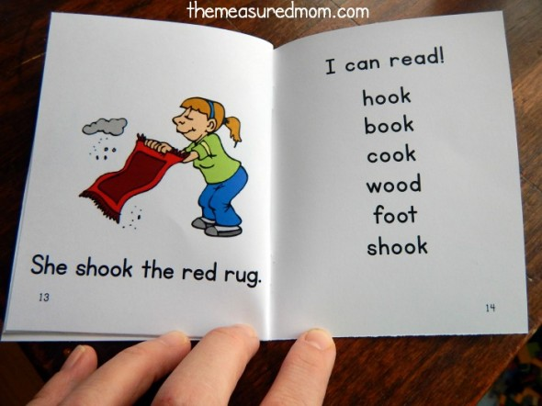
Phonetically decodable books

Slide 28
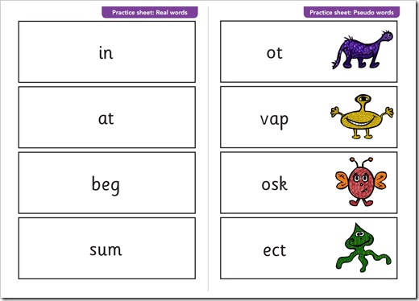
Y1 Phonics screening check

Slide 29
Thank you for coming
Feel free to ask any questions to
Mrs Wellum and Mrs Harrison

