Slide 1
Handwriting at Wharncliffe Side Primary School

Slide 2
Why handwriting?
The relevance of handwriting is sometimes questioned in a day and age when we are surrounded by laptops, iPads and smart phones. But the teaching of handwriting is just as important now as it ever has been. The need to create something of beauty never leaves the human brain and nothing beats that feeling of personal triumph when we look at something we have completed ourselves.

Slide 3
Welcome Pinchy Parrot!
Tripod grasp/grip
3 fingers gripping the pencil - one
thumb, two fingers,
pencil ‘sits back in his pillow’/ back
in his bed’.
1 cm of the yellow/black showing,
2 -3cm if left handed

Slide 4
The language of handwriting
tall letters (b d h k l )
short letters (a c e i m n o r s u v w x z)
tail letters (g j p q)
teenager t (3/4 letter)
greedy letter (f)

Slide 5
Language of handwriting
Top red line (for tall letters and capitals)
Blue/grey lines for short letters
Bottom red line for tail letters

Slide 6
Language of handwriting
BBC – bottom to back of chair
TNT – tummy near table
6 feet on the floor (chair and person)
2 hands on the table

Slide 7
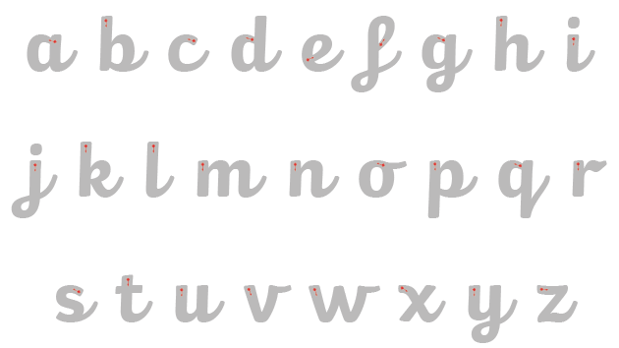
What is our handwriting style?

Slide 8
How do we teach handwriting?
We say hello to Pinchy and check our pencil grip.
We talk about the lines and the names of each line.
Then we warm up.

Slide 9
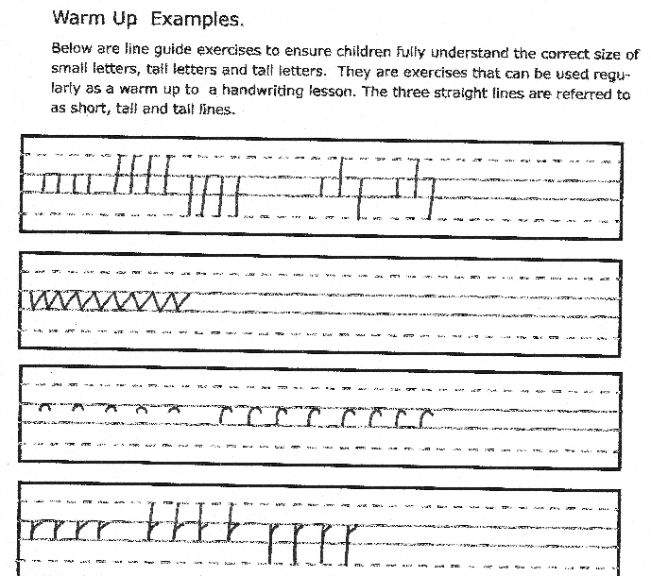

Slide 10
How do we teach handwriting?
We introduce letters a family at a time.

Slide 11
Straight line family

Slide 12
Coat hanger family

Slide 13
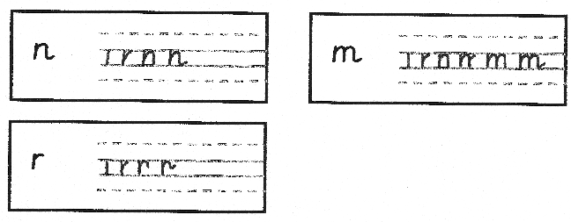
Bridge family

Slide 14
Zig Zag family

Slide 15
Smile family

Slide 16
Misfits family

Slide 17
Next steps
When children can form all the letters correctly we move onto teaching children how to join.
Once children don’t need to use the handwriting lined paper we move on to using regular lined paper or plain paper with a line guide underneath.
The majority of children should be joining their writing throughout Key Stage 2 (Year 3 upwards). They need to be joining confidently by Year 6 in order to be awarded the ‘Expected Standard’ in writing at Year 6.

